Slide 1
Office 365 Development

Slide 2
Course Agenda
Deep Dive into the Building Blocks and Services of the SharePoint Platform
Module 1: Developing Advanced Workflow Scenarios in Office 365
Module 2: Deep Dive into SharePoint Lists for Data Storage
Module 3: Deep Dive into SharePoint Lists with REST APIs
Module 4: Deep Dive into SharePoint Lists with CSOM APIs
Module 5: SharePoint 2013 Remote Event Receivers
Module 6: Deep Dive into Search Scenarios in Office 365
Module 7: Deep Dive into Business Connectivity Services in Office 365
Module 8: Developing Advanced Taxonomy Scenarios in Office 365

Slide 3
Deep Dive into Search Scenarios in Office 365
Speaker
Speaker

Slide 4

Agenda
Search Building Blocks
Extending Search Center
Search-Based Apps

Slide 5
Search Building Blocks

Slide 6
Building Blocks
Managed Properties
Result Sources
Query Rules
Result Types
Search Navigation

Slide 7
Managed Properties
Mapped to Crawled Properties
Tenancy level
Site Collection level
Site Columns Become Managed Properties
Publishing and Multiple Lines prefixed with ows_r_<four-letter-code>
Managed Metadata prefixed with ows_taxId
All others prefixed with ows_q_<four-letter-code>

Slide 8
Managed Properties
Property | Description
Queryable | Managed Property can be used in property-based searches
Refinable | Managed Property can be used as a refiner
Retrievable | Managed Property can be returned in the results
Searchable | Includes the value of the Managed Property in the Search Index
Sortable | Managed Property can be used for sorting results
Type | The data type of the Managed Property
Safe | Can be returned to anonymous users
Alias | Friendly names
Multi-valued | Managed Property can have multiple values
Notes:
Tenant
SSA
Site Collection level

Slide 9
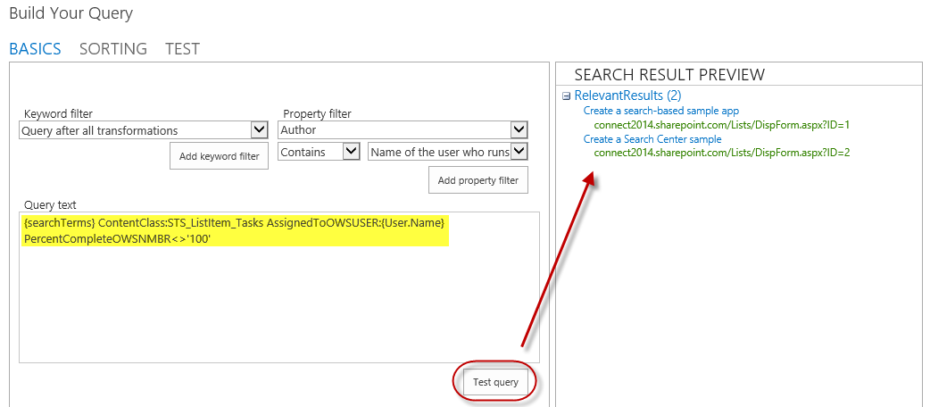
Result Sources
Select a Source
Local SharePoint Index
Remote SharePoint Index
OpenSearch
Exchange
Apply a Query Transformation
Defines a subset of the source

Slide 10
Query Rules
Applied to a given Result Source
Processed under specified conditions
Keyword match
Topic category match
Affects the query results
Alter the user’s query
Generate a Result Block

Slide 11
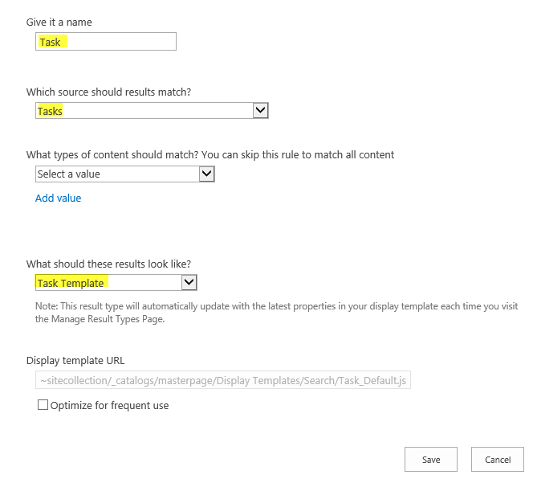
Result Types
Bound to a given Result Source
Defined by a rule
Associated with a template for display
Determines how Result Type appears
Created as an HTML file referencing Managed Properties

Slide 12
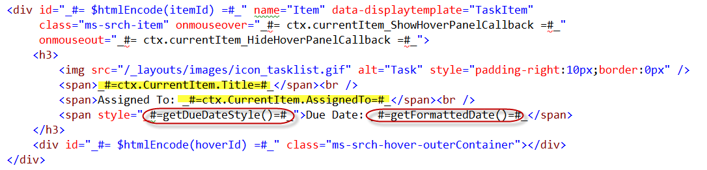
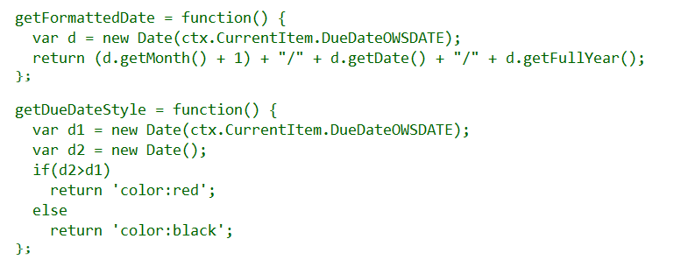
Display Templates

Slide 13
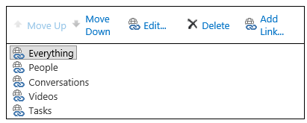
Search Navigation
Provides navigation across pages in Search Center

Slide 14
Export/Import Search Settings
Configuration export
SearchConfiguration.xml
Handles rules, sources, managed properties, etc.
Does not handle master pages, templates, and web parts
Configuration import
Import into site, site collection, tenancy
Programmatically import with app

Slide 15
Extending Search Center

Slide 16
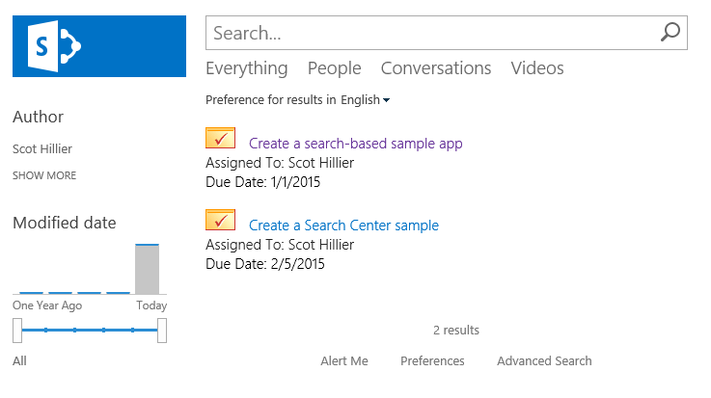
Custom Search Results
Use building blocks to create custom solutions in Search Center

Slide 17
demo
Extending Search Center

Slide 18
Search-Based Apps

Slide 19
REST Endpoint
Keywords
https://tenant/site/_api/search/query?querytext='{KQL Query}'
Selecting Properties
https://tenant/site/_api/search/query?querytext='test'&selectproperties='Title,Rank'
Sorting
https://tenant/site/_api/search/query?querytext='test'&sortlist='LastModifiedTime:descending'

Slide 20
JavaScript and REST
$.ajax(
{
url: "http://site/_api/search/" +
"query?querytext='{KQL Query}‘",
method: "GET",
headers: {
"accept": "application/json;odata=verbose",
},
success: onSuccess,
error: onError
}
);

Slide 21
JavaScript and CSOM
var context = SP.ClientContext.get_current();
var keywordQuery =
new Microsoft.SharePoint.Client.Search.Query.KeywordQuery(context);
keywordQuery.set_queryText("sharepoint");
var searchExecutor =
new Microsoft.SharePoint.Client.Search.Query.SearchExecutor(context);
results = searchExecutor.executeQuery(keywordQuery);
context.executeQueryAsync(onGetEventsSuccess, onGetEventsFail);

Slide 22
C# and REST
var spContext = SharePointContextProvider.Current.GetSharePointContext(HttpContext);
string accessToken = spContext.UserAccessTokenForSPAppWeb;
string url = "http://site/_api/search/query?querytext='sharepoint'";
HttpClient client = new HttpClient();
HttpRequestMessage request = new HttpRequestMessage(HttpMethod.Get, url);
request.Headers.Accept.Add(new MediaTypeWithQualityHeaderValue("application/xml"));
request.Headers.Authorization = new AuthenticationHeaderValue("Bearer", accessToken);
HttpResponseMessage response = await client.SendAsync(request);
string responseString = await response.Content.ReadAsStringAsync();

Slide 23
C# and CSOM
var spContext = SharePointContextProvider.Current.GetSharePointContext(Context);
using (var cctx = spContext.CreateUserClientContextForSPHost())
{
KeywordQuery query = new KeywordQuery(cctx);
query.QueryText = "{KQL}";
SearchExecutor executor = new SearchExecutor(cctx);
ClientResult<ResultTableCollection> results = executor.ExecuteQuery(query);
cctx.ExecuteQuery();
}

Slide 24
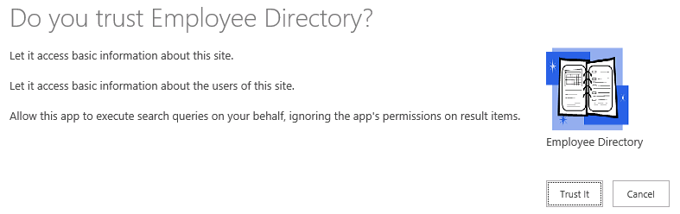
App Permissions
<AppPermissionRequest Scope=http://sharepoint/search
Right="QueryAsUserIgnoreAppPrincipal" />

Slide 25
demo
Search-Based Apps

Slide 26
Summary
Search Building Blocks
Extending Search Center
Search-Based Apps

Slide 27

© 2012 Microsoft Corporation. All rights reserved. Microsoft, Windows, and other product names are or may be registered trademarks and/or trademarks in the U.S. and/or other countries.
The information herein is for informational purposes only and represents the current view of Microsoft Corporation as of the date of this presentation. Because Microsoft must respond to changing market conditions, it should not be interpreted to be a commitment on the part of Microsoft, and Microsoft cannot guarantee the accuracy of any information provided after the date of this presentation. MICROSOFT MAKES NO WARRANTIES, EXPRESS, IMPLIED OR STATUTORY, AS TO THE INFORMATION IN THIS PRESENTATION.

